Slide 1

Cycling scotland
Jyoti pande Lavakare/Care for Air

Slide 2

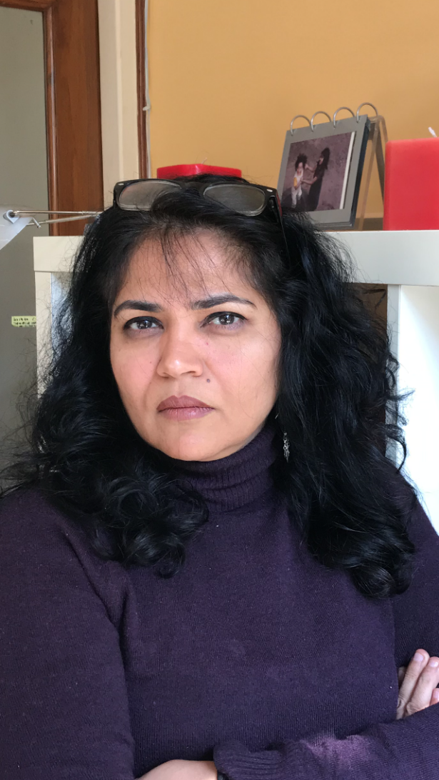
INTRODUCTION
Jyoti Pande Lavakare, former financial journalist with Dow Jones Newswires, helped start its South Asia bureau in 1995 after five years with an Indian national daily ‘The Economic Times.’
Relocated from Palo Alto, CA as a trailing spouse and stay-home mother to New Delhi in 2009. Wrote columns on start-ups until discovering the horrific pollution levels in 2014, co-founded Care for Air in 2015 (careforair.org - mission: clean air for all) registered as a non-profit in 2017
Lost mother to pollution-triggered lung cancer in 2018, wrote a book on the human cost of air pollution called “Breathing Here is Injurious to Your Health” to be released in Nov 2020 by Hachette.

Slide 3
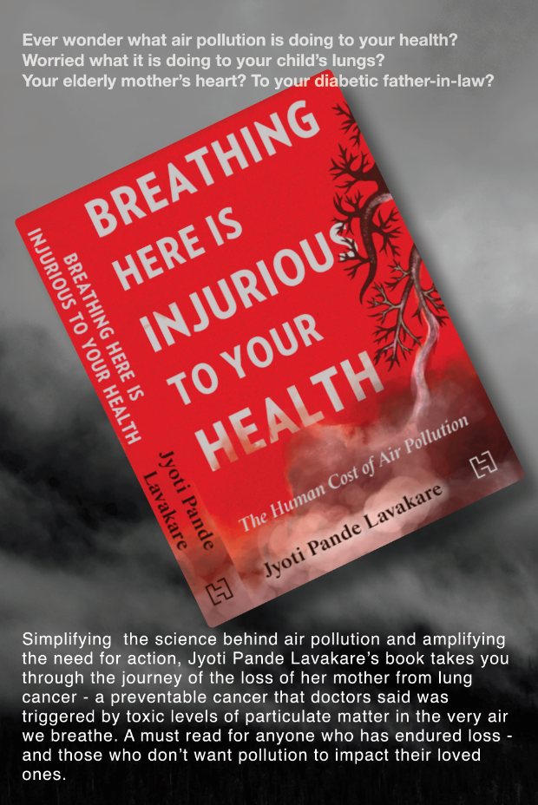
CARE FOR AIR
Care for Air began by professionals, mostly parents, as a platform to build awareness and advocate for clean air. Consists of lawyers, journalists, public health consultants, entrepreneurs. Started by going to schools, hospitals, resident associations to deliver our version of Pollution 101
One of our co-founders, a lawyer with the Supreme Court petitioned to ban fireworks - petition made on behalf of three toddlers and their fundamental right to breathe clean air.
Launched a Student Ambassador Program as a deeper dive - Pollution 201. Workshops in advocacy also.
Since we are self-funded, we work on individual strengths. Currently, we are working on simplifying and amplifying the science behind air pollution.
Looking for young people to take this voluntarily forward to college and school campuses -have identified a team

Slide 4

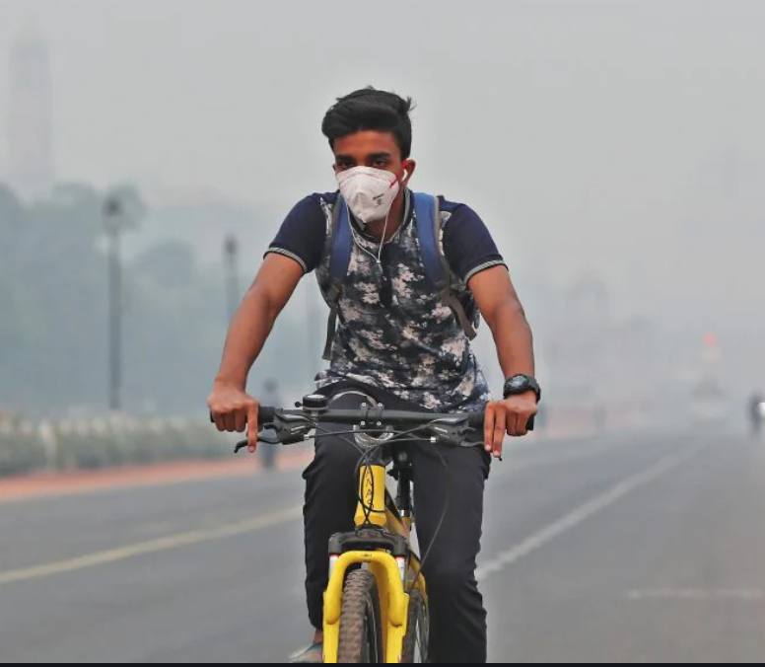
Situation & ExPERIENCE IN INDIA
Cycling in rural India is more functional - transport
Cycling In urban India has a stronger socio-economic divide - functional at the lower end of the spectrum - recreational and exercise and health at the upper end
Because the basic version of a cycle is cheap (roughly E45) it is the starting vehicle for many urban poor too
Post-pandemic cycling gaining in popularity all across socio-economic spectrum both as physically distant mode of transportation as well as p.d. exercise (gyms remain closed)
Some sellers are are reporting 30%-50% increase in sales, but the All India Cycle Manufacturers Assoc reported 25% increase in June when India’s lockdown first lifted

Slide 5
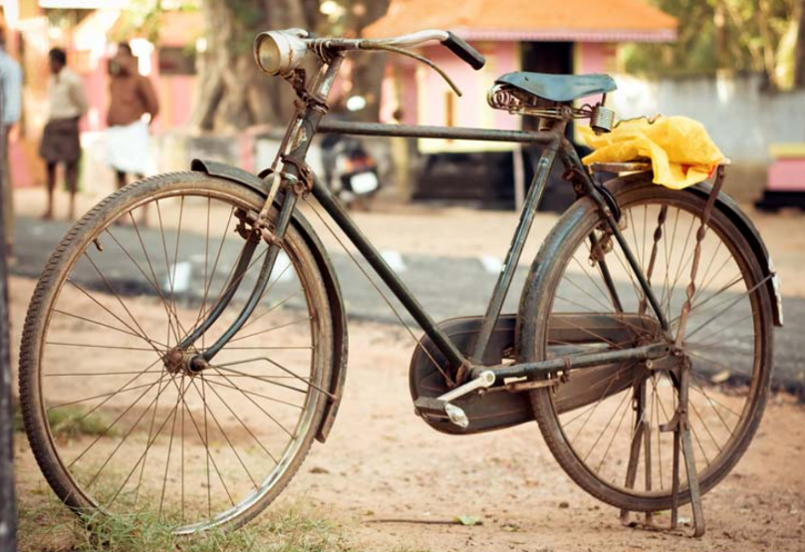
Challenges
Most of the country’s infrastructure doesn’t support cycling
No dedicated lanes, no lanes, sometimes no roads, potholed roads and no lane discipline. No road sense - by all
Cycle lanes poorly designed, intermittent when they exist. Taken over by street vendors, motorised two and three-wheelers
No traffic discipline - cyclists at the bottom of the highway hierarchy - and stray dogs. Between 2011 and 2015, about 25,435 cyclists have been killed - Govt nos, probably under-reported
16 fatalities per hour, nearly half are cyclists

Slide 6
…Challenges
Broken glass, garbage lead to punctures, frequent imbalance
Overall safety - cycling alone is as close to a death wish as you can get to in India - and cyclists are also to blame.
Safety - helmets, knee guards, reflectors, bike lights etc not used.
Several parts of India, esp the North, is either too hot (temps can go up to 50degrees in the summer) or too wet (monsoons) or too polluted
Not a status symbol in a country with aspirational youth - cars still preferred - first sign of upward mobility is scooter trades in for car
The absence of laws protecting vulnerable road users is discouraging even younger, new users. Trend reports show that many of those who take up cycling as a hobby, discontinue quite soon

Slide 7
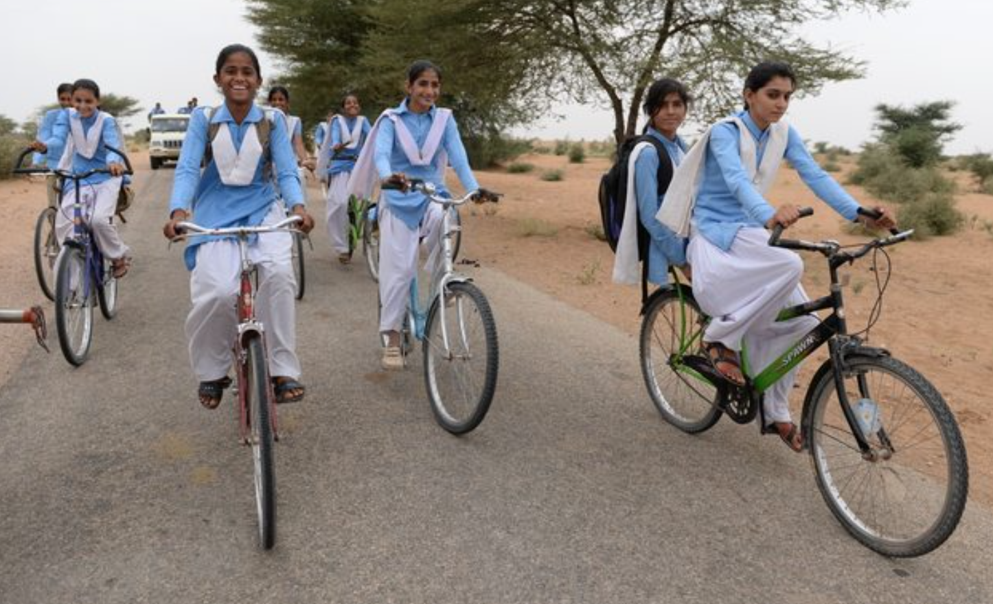
Opportunities
Cycling provides inherent, incredible, and indefinite benefits in the form of zero dependence on energy sources, zero pollution, and improved health. Bicycles can provide critical support to the urban and rural poor who do not have access to the basic mobility for seeking livelihood, education, but unfortunately, penetration still low

Slide 8
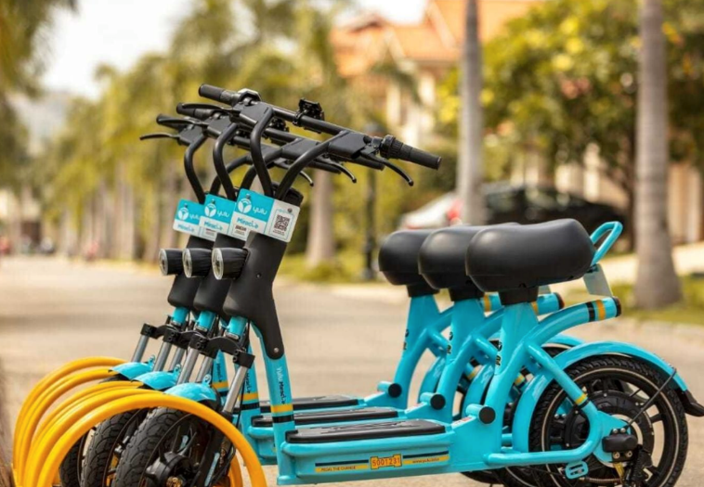
Opportunities
Cycle trips account for >15% of trips in towns, >10% in cities. Scope for increasing. Govt currently more open to creating infra for bikes post-pandemic
Chance to embed in Smart Cities plan. New Commission for Air Quality Mgt set up - chance to embed pedestrianization and cycling
Electric bike startups are coming up; even in urbanized Delhi, Yulu is providing bikes at 250 metro stations and SmartBike at neighborhoods

Slide 9
Opportunities
Indian cities, with mixed land-use patterns have relatively short commuting distances—60% of trip lengths in Indian cities are of less than 5 km, and 80% of less than 10 km - perfect for cycling
Need
- policy measures to create and provide large-scale safe cycling infrastructure,
- regulations on the use of private motorized vehicles
- prioritised subsidies/tax remittances and microfinancing options for low-income households.
- economic appraisal and quantification of the various benefits of cycling can motivate these interventions.

Slide 10
A short introduction to yourself and your work with Care for Air
• Situation and experience in India – issues and concerns regarding cycling and air quality
• Cycling and air quality – opportunities and challenges
• The role of cycling in delivering a greener future
• Key lessons for Scotland – similarities and differences; translating experiences from
India to Scotland (and other countries)

Slide 11
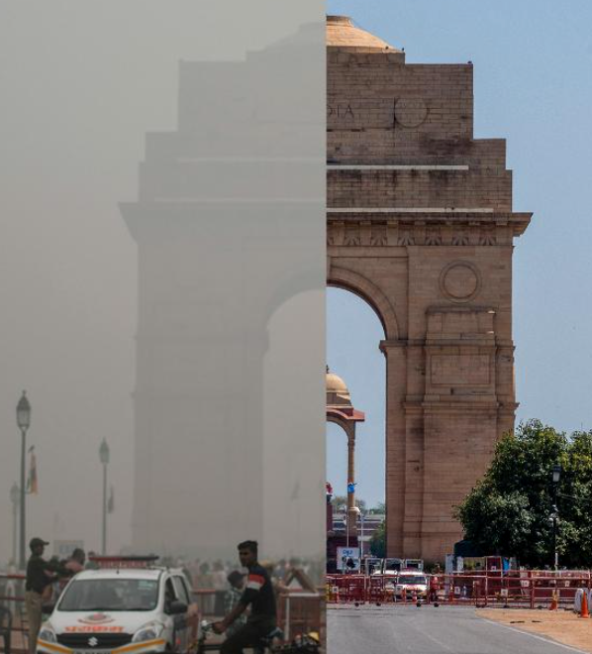
CYCLING AND AIR QUALITY
India’s dirty air kills almost 1.67 million residents each year (SOGA 2020)
Sources of PM2.5 microparticulates are many, but vehicular pollution esp in cities contributes 20-30%
Direct benefits include personal fuel savings, health benefits due to increased physical activity, reduced air pollution, and travel-time savings by marginal unskilled workers
Indirect benefits that accrue to society due to a modal shift towards cycling are include energy savings and reduced CO2 emissions have been estimated.
The Energy Research Institute has conducted one of the few studies on cycling; more info

Slide 12
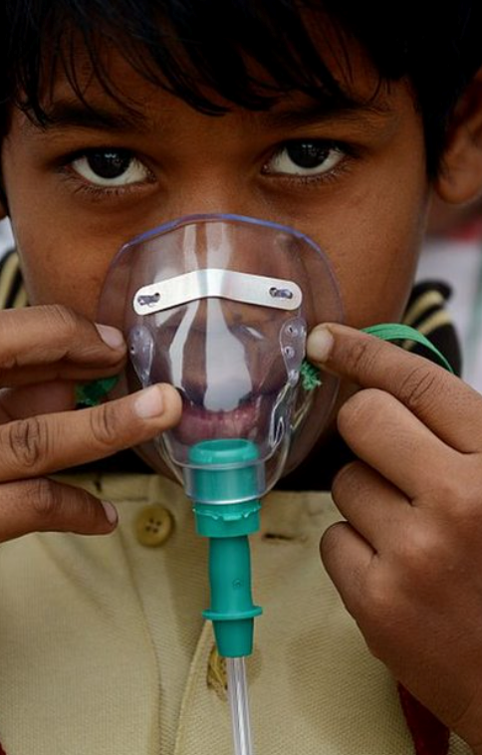
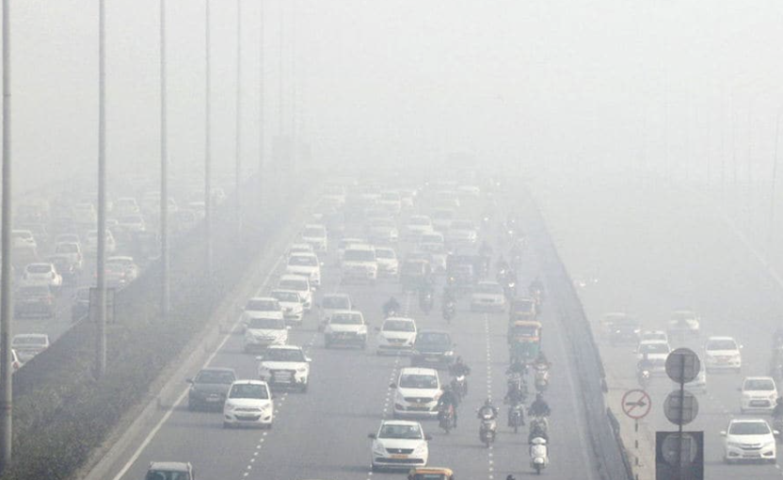
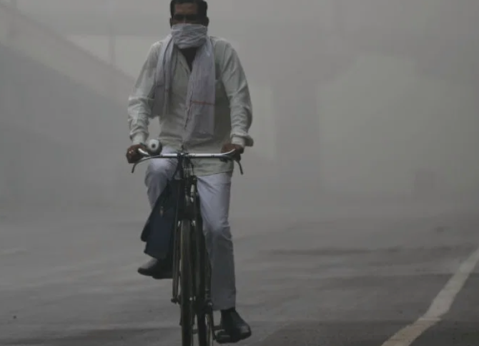

Slide 13
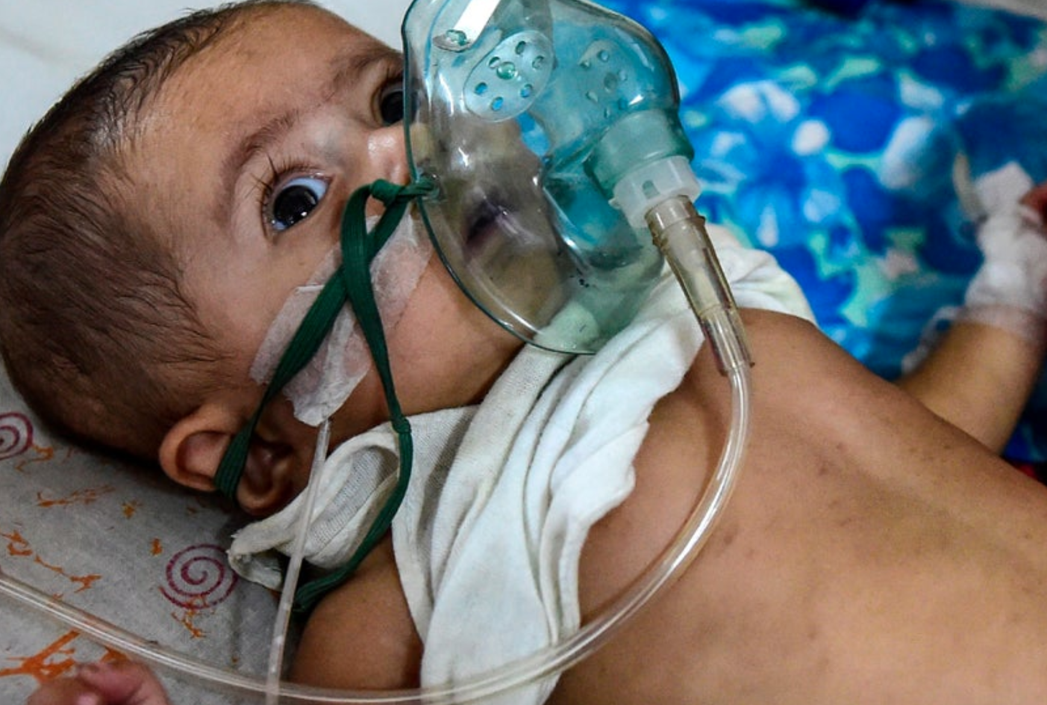
116,000 infants killed within months of being born in 2019: SOGA
AP is not just a Delhi problem - all India, all season
Affects not just lungs but all organs -70,000 papers (WHO)
Social inequity - affects poor more, no mitigation

